Slide 1

International commercial law: Introduction to arbitration
Miloš Novović, PhD
Associate Professor of Law, BI Norwegian Business School

Slide 2
Welcome!
Today’s lecture
We will introduce arbitration as an alternative to litigation
We will talk about key characteristics of arbitration as an ADR mechanism
We will try to understand the basic legal framework the arbitration operates in
We will introduce new legal sources, such as New York Convention
We will discuss options for challenging arbitral awards

Slide 3
Reading materials
You should read Chapter 5 in GCM textbook. Some of the discussions there might be too detailed for this course. Additional material on arbitration will be posted on itsLearning.

Slide 4
International commercial arbitration

Slide 5
Material (substantive) law: CISG
Procedural law: Norwegian Arbitration Act

Slide 6
What is arbitration?
Arbitration is a form of alternative dispute resolution (ADR).
There are many ADR mechanisms, where parties try to avoid taking their dispute to court.
Why?

Slide 7
Chinese proverb (allegedly)
“In death, avoid Hell. In life, avoid courts of law.”

Slide 8
What is arbitration?
“A process by which parties consensually submit a dispute to a non-governmental decision-maker, selected by or for the parties, to render a binding decision resolving a dispute in accordance with neutral, adjudicatory procedures affording each party an opportunity to present its case”.

Slide 9
Consensual means to resolve disputes
“Arbitration is a matter of contract and a party cannot be required to submit to arbitration any dispute which it has not agreed so to submit.”
No arbitration agreement = no arbitration
Non-governmental decision-maker selected by or for the parties
If governmental decision-maker is selected, then we have a choice of forum (choice of court), not an arbitration agreement
Arbitrators usually selected by the parties (ad-hoc arbitration) or by specialized arbitral institutions on their behalf (institutional arbitration, such as Oslo Chamber of Commerce)
Final and binding decision – “award”
It does not result in a merely advisory recommendation
Adjudicatory procedure
Arbitral award can be coercively enforced (New York Convention)
Impartial procedure allowing each party to present its case

Slide 10
Arbitration agreement 1
“Any dispute, controversy or claim arising out of or relating to this contract, or the breach, termination or invalidity thereof, shall be settled by Arbitration in accordance with the UNCITRAL Arbitration Rules in effect on the date of this contract. The appointing authority shall be the Arbitration and Dispute Resolution Institute of the Oslo Chamber of Commerce.”

Slide 11
Arbitration agreement 2 - invalid
“Any and all disputes arising out of this contract shall be resolved by a panel of three arbitrators, seated in London, who shall investigate the necessary facts and render an award which, upon being endorsed by all the parties, shall become binding and enforceable.”

Slide 12
Litigation vs. arbitration - terms
Litigation
Judge
Court
Judgement
Arbitration
Arbitrator
Arbitral tribunal
Arbitral award

Slide 13
Goal of arbitration
Ultimate goal is for an arbitral tribunal to “render” (make) an “arbitral award” (their ruling)
Most parties comply voluntarily with these rulings (why?)
If the parties do not comply with arbitral awards, courts will force them to do so, without really reviewing the reasoning behind the award (courts trust arbitrators – why?)

Slide 14
Legal framework
(important)

Slide 15
Arbitration agreement
Contractual; an absolute requirement
Arbitration rules
Contractual; extension of the agreement between the parties. Usually used if arbitration is administered by an institution. Regulate procedural questions.
Legislative; New York Convention is the most important instrument; regulates recognition and enforcement of foreign arbitral awards
Legislative; law of the place where arbitration is taking place
National arbitration legislation (lex arbitri)
International conventions
E.g.: ICC Rules, UNCITRAL Rules, LCIA Rules, SCC Rules..
Eg: Arbitration in Oslo: Norwegian Arbitration Act applies
Typically only a few mandatory rules that the parties cannot deviate from, such as principle of fair hearing; lots of default rules on procedure
Defines relationship between courts and arbitral tribunals/awards
Courts must enforce foreign arbitral awards under NYC unless very narrow set of criteria is met

Slide 16
Arbitration agreement
Without agreement of the parties, there is no arbitration (they would just go to court)
Must be drafted precisely, and can include a number of specific provisions on how arbitration is to be carried out
Principle of separability: arbitration agreement’s validity is independent of the validity of the main contract
  Example: You terminate a contract under CISG, but the arbitration clause is still valid. You therefore can’t go to court instead of arbitration.

Slide 17
Arbitration agreement
Presumptively valid
  NYC 2(1): “Each Contracting State shall recognize an agreement in writing under which the parties undertake to submit to arbitration all or any differences which have arisen or which may arise between them in respect of a defined legal relationship, whether contractual or not, concerning a subject matter capable of settlement by arbitration.”
But what if one of the parties refuses to comply?
  Specific performance mandated by the NYC 2(3): “The court of a Contracting State, when seized of an action in a matter in respect of which the parties have made an agreement within the meaning of this article, shall, at the request of one of the parties, refer the parties to arbitration, unless it finds that the said agreement is null and void, inoperative or incapable of being performed.”

Slide 18
Arbitration agreement
Parties can agree on any and all procedural aspects of arbitration in their agreement, as long as this is in line with the (typically rare) mandatory provisions of lex arbitri
Example: “Buyer and seller agree to resolve all disputes in mandatory arbitration, held in Oslo. Number of arbitrators shall be three. Parties undertake to cover their own costs of evidence discovery. Buyer reserves the right to present the case first.”

Slide 19
Institutional rules
Some international institutions specialize in providing internatitonal commercial arbitration services
They offer help finding arbitrators, setting up meetings, presenting evidence…
They also offer procedural framework for carrying out the arbitration, via their rules

Slide 20
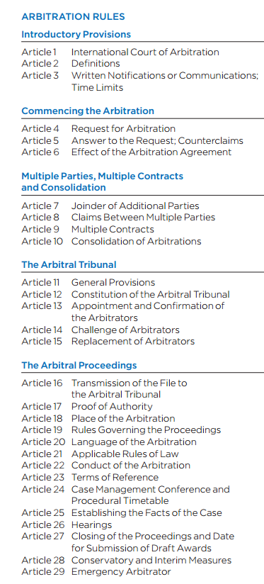
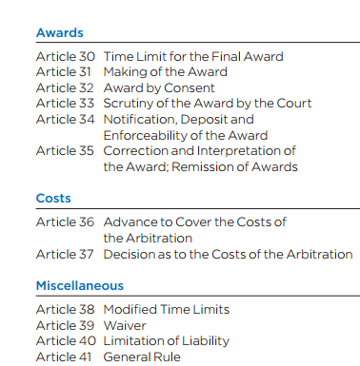
Example: ICC rules

Slide 21
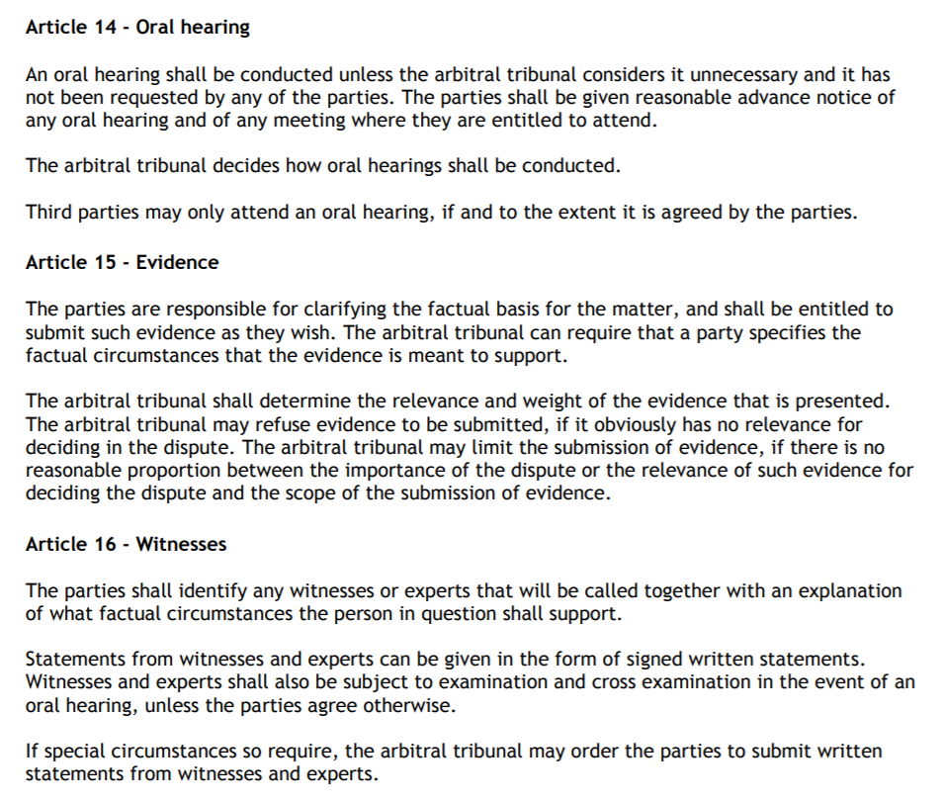
Institutional rules: Oslo Chamber of Commerce

Slide 22
Institutional rules
Arbitration rules are contractual in nature – they have the same effect as if the parties wrote them into their contract
We also find some rules for ad-hoc arbitrations, such as UNCITRAL Rules on Arbitration
Rules are contractual, so they can’t contradict mandatory norms of lex arbitri (but can change default ones)

Slide 23
National legislation (lex arbitri)
Law of the country where arbitration is taking place (“seat of arbitration”), dealing with questions of arbitration
Norwegian Arbitration Act
US FAA
UK Arbitration Act
Regulates “internal” procedures of arbitration and “external” relationship with the courts of the seat
Few mandatory “internal” rules; but “external” ones are important!

Slide 24
National legislation (lex arbitri): validity
Most awards are voluntarily complied with
Court review of awards is typically very limited
Still, most national laws contain some limited grounds for “setting aside”/”invalidating”/”annulling” arbitral awards – “validity challenge”
Before the courts of the seat, and under lex arbitri, which gives courts grounds to set the award aside
Example: In Norway, under Norwegian AA, you can ask the court to set the award aside if the arbitral award is “contrary to Norwegian public policy”

Slide 25
International framework: NYC
Convention on the Recognition and Enforcement of Foreign Arbitral Awards (New York, 1958) (the "New York Convention")
“A single set of international legal standards for the enforcement of arbitration agreements and awards”.
As such, it does not cover all the aspects of arbitral proceedings – but is still immensely important
Effects:
  Requires national courts to recognize and enforce foreign awards, subject to a limited set of exceptions
  Requires national courts to recognize and enforce arbitration agreements, subject to a limited set of exceptions
  Requires national courts to refer parties to arbitration, when there is a valid agreement
Courts don’t get to review the merits before enforcing an award!

Slide 26
NYC: Grounds for denying recognition
Arbitration agreement invalid; no capacity
Party denied opportunity to present its case
Award deals with matters outside the scope of agreement
Composition of tribunal or procedure is not in line with the agreement
Award not binding or annulled in seat
Disputes were not arbitrable
Award violates public policy

Slide 27
Litigate or arbitrate?
(May 20, 1751)
[L]et me tell you that after you have expended large Sums of Money, and squander'd away a deal of Time & Attendance on your lawyers, and Preparations for Hearings one Term after another, you will probably be of another Mind, and be glad Seven Years hence to leave it to that Arbitration which you now refuse.

Slide 28
Litigate or arbitrate?
Neutrality
Centralized dispute resolution
Enforceability of agreements and awards
Commercial competence and expertise
Finality of decisions
Party autonomy and procedural flexibility
Confidentiality
Cost and speed

Slide 29
Cases

Slide 30
Case 1
You receive the following clause in seller’s model contract:
“13. Settlement of disputes – … any disputes or difference… shall be adjudicated upon under the Rules of Conciliation and Arbitration of the International Chamber of Commerce by one or more Arbitrators appointed in accordance with those Rules.
14. Language and law – This Agreement is written in the English language and shall be interpreted according to English law. The Courts of England shall have exclusive jurisdiction over it to which jurisdiction the parties hereby submit.”
Do you sign? Why?

Slide 31
Case 2
You receive the following clause in seller’s model contract:
“Any and all such disputes shall be finally resolved by arbitration before the Singapore International Arbitration Centre in accordance with the Rules of Arbitration of the International Chamber of Commerce …”
Do you sign? Why?

Slide 32
Case 3
Your contract provides: “Any and all disputes shall be resolved by mandatory arbitration under the rules of Oslo Chamber of Commerce. The tribunal may not order any interim measures.”
OCC Rules provide: “The arbitral tribunal may, at the request of a party, order any party to take such interim and conservatory measures as the arbitral tribunal considers necessary based on the subject matter of the dispute.”
May you file for an interim measure before the tribunal?

Slide 33
Thank you!
Milos Novovic
milos.novovic@bi.no
+47 974 22 223

